Slide 1
Computing Technology

Slide 2
Announcements

Slide 3
Computing Technology

Slide 4


URL
Notes:
https://emojipedia.org/apple/ios-17.4/selfie

Slide 5
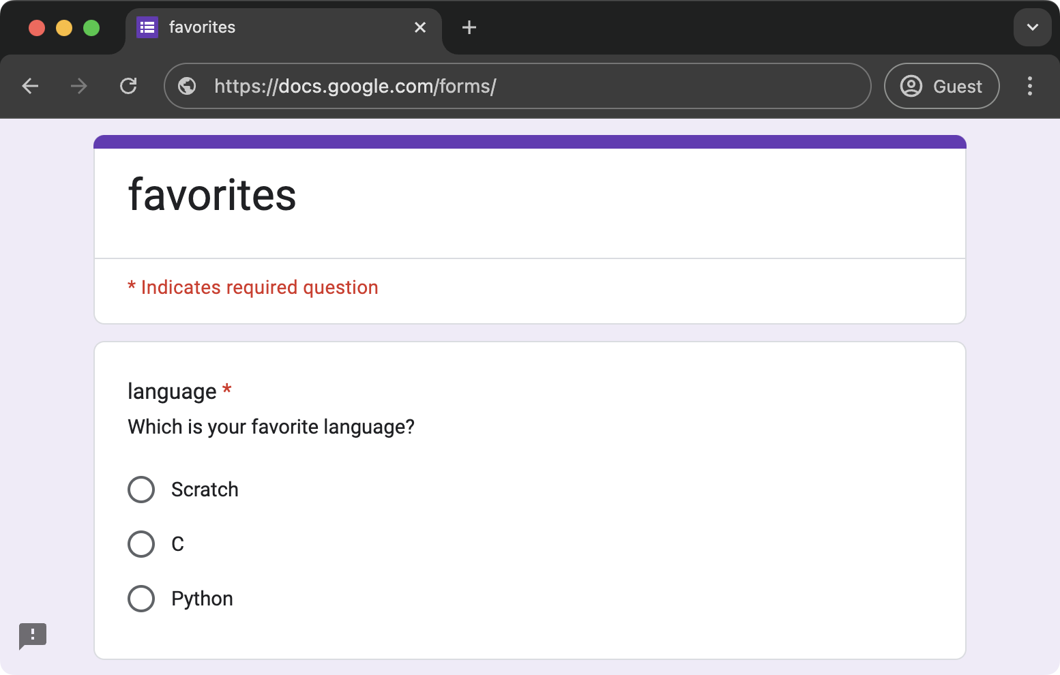
Notes:
https://docs.google.com/forms/d/e/1FAIpQLScxhPm4DSar6J8Yh1yMBEPQ0ihA6s3RuCUdVygr-3wB6jR4Rg/viewform

Slide 6
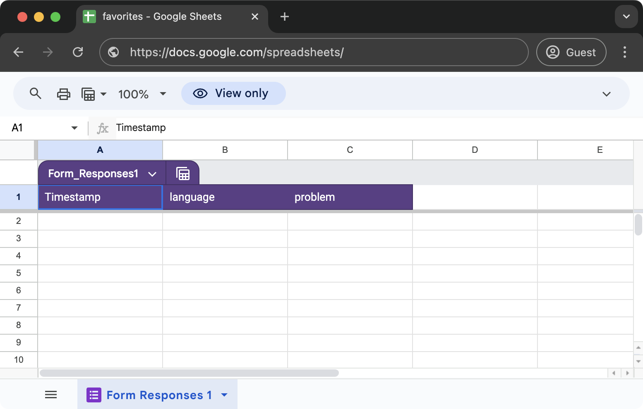
Notes:
https://docs.google.com/spreadsheets/d/1Todn2bYuRz_LqYrOaJy-A9XVoynhncqICRTnHluc38o/edit?usp=sharing

Slide 7
flat-file database

Slide 8
CSV
Notes:
favorites{0,1,2,3,4}.py

Slide 9
key | value
Notes:
favorites{5,6,7,8}.py

Slide 10
relational database

Slide 11
SQL

Slide 12
C
R
U
D

Slide 13
CREATE
READ
UPDATE
DELETE

Slide 14
CREATE
SELECT
UPDATE
DELETE

Slide 15
CREATE, INSERT
SELECT
UPDATE
DELETE

Slide 16
CREATE, INSERT
SELECT
UPDATE
DELETE, DROP

Slide 17
CREATE, INSERT
SELECT
UPDATE
DELETE, DROP
...

Slide 18
CREATE TABLE table (column type, ...);

Slide 19
sqlite3

Slide 20
sqlite3 FILE

Slide 21
.mode csv
.import FILE TABLE
.quit
Notes:
favorites.csv

Slide 22
.schema

Slide 23
SELECT columns FROM table;
...
Notes:
SELECT * FROM favorites;
SELECT language FROM favorites;

Slide 24
AVG
COUNT
DISTINCT
LOWER
MAX
MIN
UPPER
...
Notes:
SELECT COUNT(*) FROM favorites;
SELECT DISTINCT language FROM favorites;
SELECT COUNT(DISTINCT language) FROM favorites;

Slide 25
GROUP BY
LIKE
LIMIT
ORDER BY
WHERE
...
Notes:
SELECT COUNT(*) FROM favorites WHERE language = 'C';
SELECT COUNT(*) FROM favorites WHERE language = 'C' AND problem = 'Hello, World';
SELECT COUNT(*) FROM favorites WHERE language = 'C' AND (problem = 'Hello, World' OR problem = 'Hello, It''s Me');
SELECT COUNT(*) FROM favorites WHERE language = 'C' AND problem LIKE 'Hello, %';

Slide 26
language
C
Python
Python
SQL
Python
SQL
Notes:
SELECT language, COUNT(*) FROM favorites GROUP BY language;

Slide 27
language
C
Python
Python
SQL
Python
SQL

Slide 28
language
C
Python
Python
SQL
Python
SQL

Slide 29
language
C
Python
Python
SQL
Python
SQL

Slide 30
language | COUNT(*)
C | 1
Python | 3
SQL | 2

Slide 31
GROUP BY
LIKE
LIMIT
ORDER BY
WHERE
...
Notes:
SELECT language, COUNT(*) FROM favorites GROUP BY language ORDER BY COUNT(*) DESC;
SELECT language, COUNT(*) AS n FROM favorites GROUP BY language ORDER BY n DESC;
SELECT language, COUNT(*) AS n FROM favorites GROUP BY language ORDER BY n DESC LIMIT 1;

Slide 32
INSERT INTO table (column, ...) VALUES(value, ...);
Notes:
INSERT INTO favorites (language, problem) VALUES('SQL', 'Fiftyville');
SELECT * FROM favorites;

Slide 33
NULL

Slide 34
DELETE FROM table WHERE condition;
Notes:
DELETE FROM favorites WHERE Timestamp IS NULL;

Slide 35
UPDATE table SET column = value WHERE condition;
Notes:
UPDATE favorites SET language = 'SQL', problem = 'Fiftyville';
SELECT * FROM favorites;
DELETE FROM favorites;
SELECT * FROM favorites;

Slide 36
IMDb
Notes:
https://docs.google.com/spreadsheets/d/15g5bRE3WF2PgkCm9LhKn2hdOmTxhk9aX_U06TMYcu0A/edit?usp=sharing
https://docs.google.com/spreadsheets/d/1tETwE0k0tERu1p1aOt8Rfitot1k3f77ywS8kicBPqdg/edit?usp=sharing
https://docs.google.com/spreadsheets/d/1Ey_E4W1LsHYp2MPWMqv8Q8IFNDcoAth_hUQNx3j3uV8/edit?usp=sharing

Slide 37
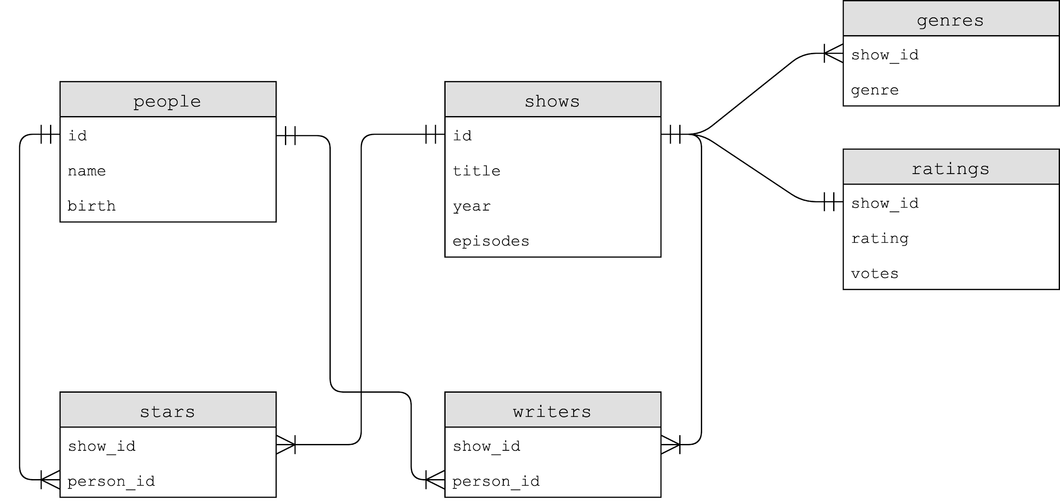

Slide 38
Notes:
SELECT * FROM shows LIMIT 10;
SELECT * FROM ratings LIMIT 10;

Slide 39
one-to-one

Slide 40
Notes:
.schema shows
.schema ratings

Slide 41
BLOB
INTEGER
NUMERIC
REAL
TEXT

Slide 42
NOT NULL
UNIQUE

Slide 43
PRIMARY KEY
FOREIGN KEY
Notes:
SELECT * FROM ratings WHERE rating >= 6.0 LIMIT 10;
SELECT show_id FROM ratings WHERE rating >= 6.0 LIMIT 10;
SELECT * FROM shows WHERE id IN (SELECT show_id FROM ratings WHERE rating >= 6.0) LIMIT 10;
SELECT title FROM shows WHERE id IN (SELECT show_id FROM ratings WHERE rating >= 6.0) LIMIT 10;

Slide 44
JOIN

Slide 45
id | title
386676 | The Office
show_id | rating
386676 | …

Slide 46
title | id
The Office | 386676
show_id | rating
386676 | …

Slide 47
title | id
The Office | 386676
show_id | rating
386676 | …
Notes:
SELECT * FROM shows JOIN ratings ON shows.id = ratings.show_id WHERE rating >= 6.0 LIMIT 10;

Slide 48
title | id
The Office | 386676
show_id | rating
386676 | …

Slide 49
title | id
The Office | 386676
rating
…

Slide 50
title
The Office
rating
…
Notes:
SELECT title, rating FROM shows JOIN ratings ON shows.id = ratings.show_id WHERE rating >= 6.0 LIMIT 10;

Slide 52
Notes:
SELECT * FROM genres LIMIT 10;
SELECT * FROM shows WHERE id = 63881;

Slide 53
one-to-many
Notes:
.schema genres
SELECT genre FROM genres WHERE show_id = 63881;
SELECT genre FROM genres WHERE show_id = (SELECT id FROM shows WHERE title = 'Catweazle');

Slide 54
id | title
63881 | Catweazle
show_id | genre
63881 | Adventure
63881 | Comedy
63881 | Family

Slide 55
title | id
Catweazle | 63881
show_id | genre
63881 | Adventure
63881 | Comedy
63881 | Family

Slide 56
title | id
Catweazle | 63881
show_id | genre
63881 | Adventure
63881 | Comedy
63881 | Family
Notes:
SELECT * FROM shows JOIN genres ON shows.id = genres.show_id WHERE id = 63881;

Slide 57
title | id
Catweazle | 63881
show_id | genre
63881 | Adventure
63881 | Comedy
63881 | Family

Slide 58
title | id
Catweazle | 63881
Catweazle | 63881
Catweazle | 63881
show_id | genre
63881 | Adventure
63881 | Comedy
63881 | Family

Slide 59
title | id
Catweazle | 63881
Catweazle | 63881
Catweazle | 63881
genre
Adventure
Comedy
Family

Slide 60
title
Catweazle
Catweazle
Catweazle
genre
Adventure
Comedy
Family
Notes:
SELECT title, genre FROM shows JOIN genres ON shows.id = genres.show_id WHERE id = 63881;

Slide 61
genre
Adventure
Comedy
Family
Notes:
SELECT genre FROM shows JOIN genres ON shows.id = genres.show_id WHERE id = 63881;

Slide 64
many-to-many
Notes:
SELECT * FROM shows WHERE title = 'The Office';
SELECT * FROM shows WHERE title = 'The Office' AND year = 2005;
SELECT name FROM people WHERE id IN
(SELECT person_id FROM stars WHERE show_id =
(SELECT id FROM shows WHERE title = 'The Office' AND year = 2005));
SELECT title FROM shows WHERE id IN
(SELECT show_id FROM stars WHERE person_id =
(SELECT id FROM people WHERE name = 'Steve Carell'));
SELECT title FROM shows
JOIN stars ON shows.id = stars.show_id
JOIN people ON stars.person_id = people.id
WHERE name = 'Steve Carell';
SELECT title FROM shows, stars, people WHERE shows.id = stars.show_id
AND people.id = stars.person_id
AND name = 'Steve Carell';

Slide 65
Notes:
.schema writers

Slide 66
indexes
Notes:
.timer ON
SELECT * FROM shows WHERE title = 'The Office';

Slide 67
CREATE INDEX name ON table (column, ...);
Notes:
CREATE INDEX title_index ON shows (title);
SELECT * FROM shows WHERE title = 'The Office';

Slide 68
B-trees

Slide 69
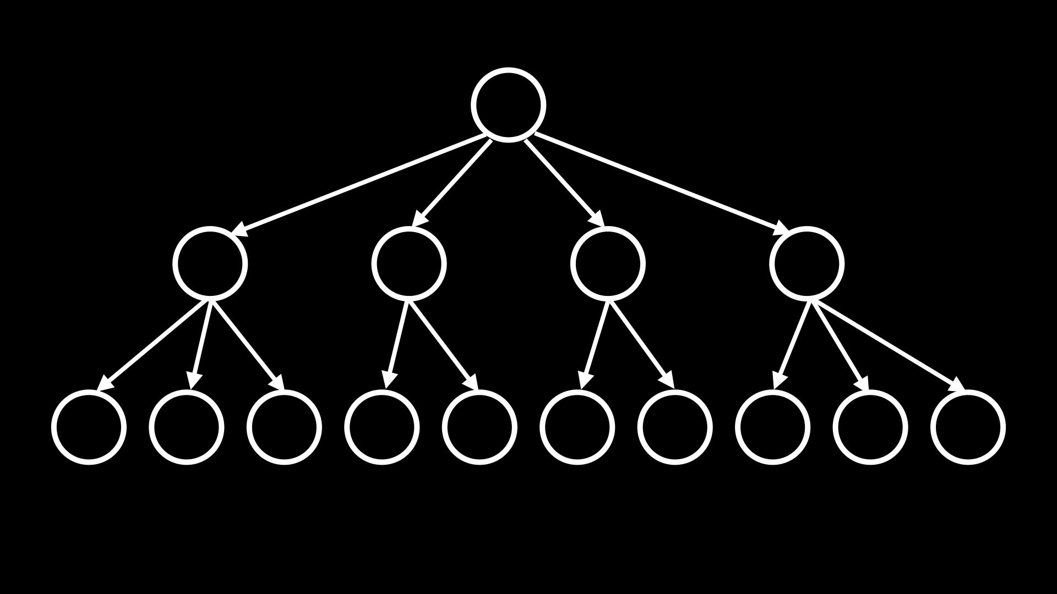
Notes:
SELECT title FROM shows, stars, people
WHERE shows.id = stars.show_id
AND people.id = stars.person_id
AND name = 'Steve Carell';
SELECT title FROM shows WHERE id IN
(SELECT show_id FROM stars WHERE person_id =
(SELECT id FROM people WHERE name = 'Steve Carell'));
CREATE INDEX name_index ON people (name);
CREATE INDEX person_index ON stars (person_id);
SELECT title FROM shows WHERE id IN
(SELECT show_id FROM stars WHERE person_id =
(SELECT id FROM people WHERE name = 'Steve Carell'));

Slide 70
from cs50 import SQL

Slide 71
cs50.readthedocs.io/libraries/cs50/python/#cs50.SQL
Notes:
favorites8.py

Slide 72
race conditions
Notes:
MILK STORY (lock or note)

Slide 73

Notes:
https://www.instagram.com/p/CmUv48DLvxd/

Slide 74
rows = db.execute("SELECT likes FROM posts WHERE id = ?", id);
likes = rows[0]["likes"]
db.execute("UPDATE posts SET likes = ? WHERE id = ?", likes + 1, id);

Slide 75
BEGIN TRANSACTION
COMMIT
ROLLBACK

Slide 76
db.execute("BEGIN TRANSACTION")
rows = db.execute("SELECT likes FROM posts WHERE id = ?", id);
likes = rows[0]["likes"]
db.execute("UPDATE posts SET likes = ? WHERE id = ?", likes + 1, id);
db.execute("COMMIT")

Slide 77
SQL injection attacks

Slide 78
rows = db.execute("SELECT * FROM users WHERE username = ? AND password = ?", username, password)
if rows:
...

Slide 79
rows = db.execute("SELECT * FROM users WHERE username = ? AND password = ?", username, password)
if rows:
...

Slide 80
rows = db.execute("SELECT * FROM users WHERE username = ? AND password = ?", username, password)
if rows:
...

Slide 81
rows = db.execute(f"SELECT * FROM users WHERE username = '{username}' AND password = '{password}'")
if rows:
...

Slide 82
rows = db.execute(f"SELECT * FROM users WHERE username = 'malan@harvard.edu'--' AND password = '{password}'")
if rows:
...

Slide 83
rows = db.execute(f"SELECT * FROM users WHERE username = 'malan@harvard.edu'--' AND password = '{password}'")
if rows:
...

Slide 84
rows = db.execute(f"SELECT * FROM users WHERE username = 'malan@harvard.edu'--' AND password = '{password}'")
if rows:
...

Slide 85
rows = db.execute(f"SELECT * FROM users WHERE username = 'malan@harvard.edu''--' AND password = '{password}'")
if rows:
...

Slide 86
rows = db.execute("SELECT * FROM users WHERE username = ? AND password = ?", username, password)
if rows:
...

Slide 87
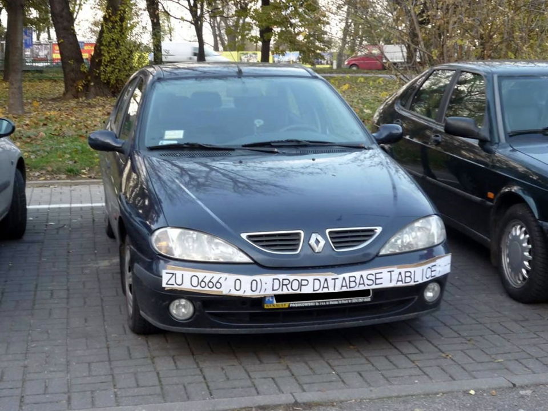

Slide 88
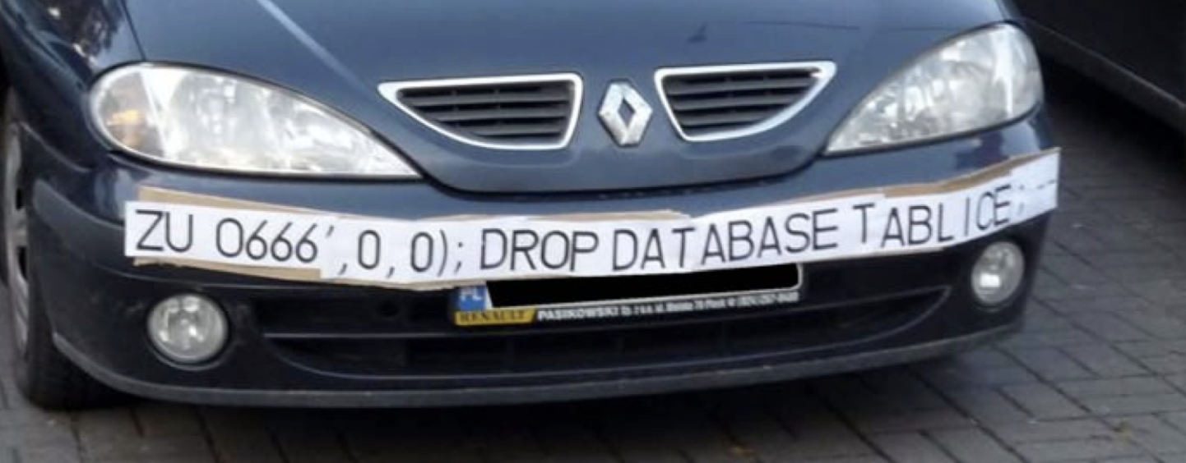

Slide 89

Notes:
https://xkcd.com/327/

Slide 90
Computing Technology

